Slide 1
Lecture 4 Data storage, creation & editing

Slide 2
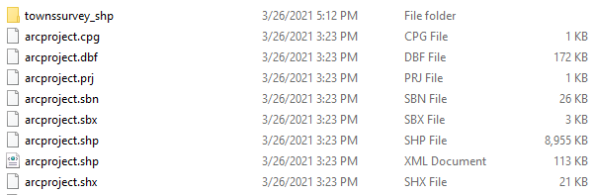
How is data stored?
Shapefiles are still a popular format
Consist of several separate files (if you look in folder you will see many components for one .shp
.dbf = attribute table
.prj = projection file
.shp = contains geometry information

Slide 3
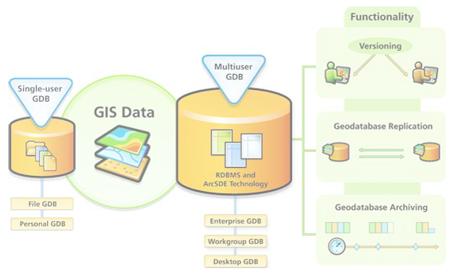
Geodatabase
The geodatabase is the common data storage and management framework for ArcGIS. It combines "geo" (spatial data) with "database" (data repository) to create a central data repository for spatial data storage and management. It can be leveraged in desktop, server, or mobile environments and allows you to store GIS data in a central location for easy access and management.

Slide 4
Geodatabase
The geodatabase offers you the ability to:
Store a rich collection of spatial data in a centralized location.
Apply sophisticated rules and relationships to the data.
Define advanced geospatial relational models (e.g., topologies, networks).
Maintain integrity of spatial data with a consistent, accurate database.
Work within a multiuser access and editing environment.
Integrate spatial data with other IT databases.
Easily scale your storage solution.
Support custom features and behavior.

Slide 5
Kinds/types of Geodatabase
The geodatabase is a "container" used to hold a collection of datasets. There are 2 types:
File geodatabase — Stored as folders in a file system. Each dataset is held as a file that can scale up to 1 TB in size. The file geodatabase is recommended over personal geodatabases. This is the geodatabase you use.
ArcSDE geodatabase — Also known as multiuser geodatabases. Stored in a relational database using Oracle, Microsoft SQL Server, IBM DB2, IBM Informix, or PostgreSQL. These geodatabases require the use of ArcSDE and can be unlimited in size and numbers of users.

Slide 6
Where does data come from?
Many sources for existing geospatial datasets (we’ve been discussing this and will continue to do so)
Vector: Initially, somebody had to collect, create, digitize all the points, lines, and polygons
Field data collection
GPS
Surveys
Paper maps
Raster: Often a product of remote sensing
Photo interpretation
Orthophotos
Satellite imagery

Slide 7
Digitizing
Scanned to digital format maps or aerial photographs used to create data:
Paper hard copy maps must be scanned to digital file format
Images must be georeferenced once in GIS
Trace features and record locations
Can still be very time-consuming

