Slide 1
Lecture 3 Elements of a Map Cartography Use of Data Frames

Slide 2
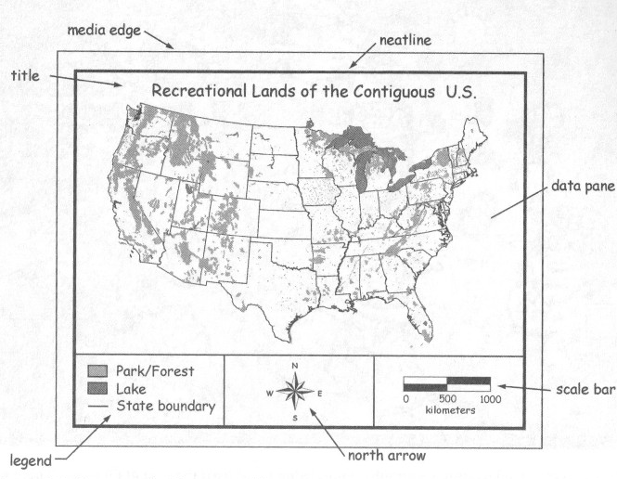
Map Basics
Title
Legend
North Arrow
Scale Bar
Source/Date
Source/Date

Slide 3
What are map basics
Title = describes topic/theme of map
Legend = key to symbology
North Arrow = orient map in right direction
Scale Bar = show relation of map area to real world area
Source/Date = metadata, i.e. can you trust the map

Slide 4
Types of maps
Feature = basic simple map
Size, distance, direction, such as route map or region map
Thematic
Deals with a theme – tells a story, such as healthy vegetation or weather map
Chloropleth
Uses graded differences in shading or color based on value
Different size symbols to indicate average values
Dot Density
Uses dot symbol to show presence and density
Isopleth or Contour
Uses isobars to show height or depth, i.e. mountains or ocean/lake depth

Slide 5
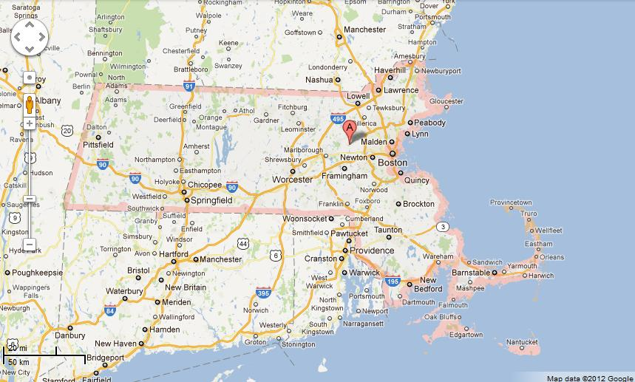
Feature Map

Slide 6
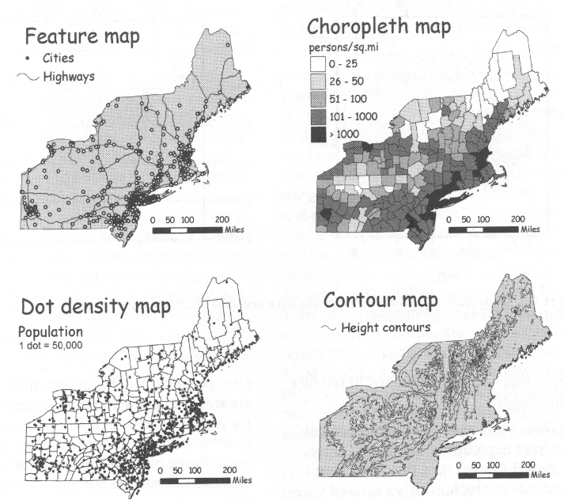
Thematic Maps
Feature Map
Choropleth
Dot Density
Isopleth/Contour

Slide 7
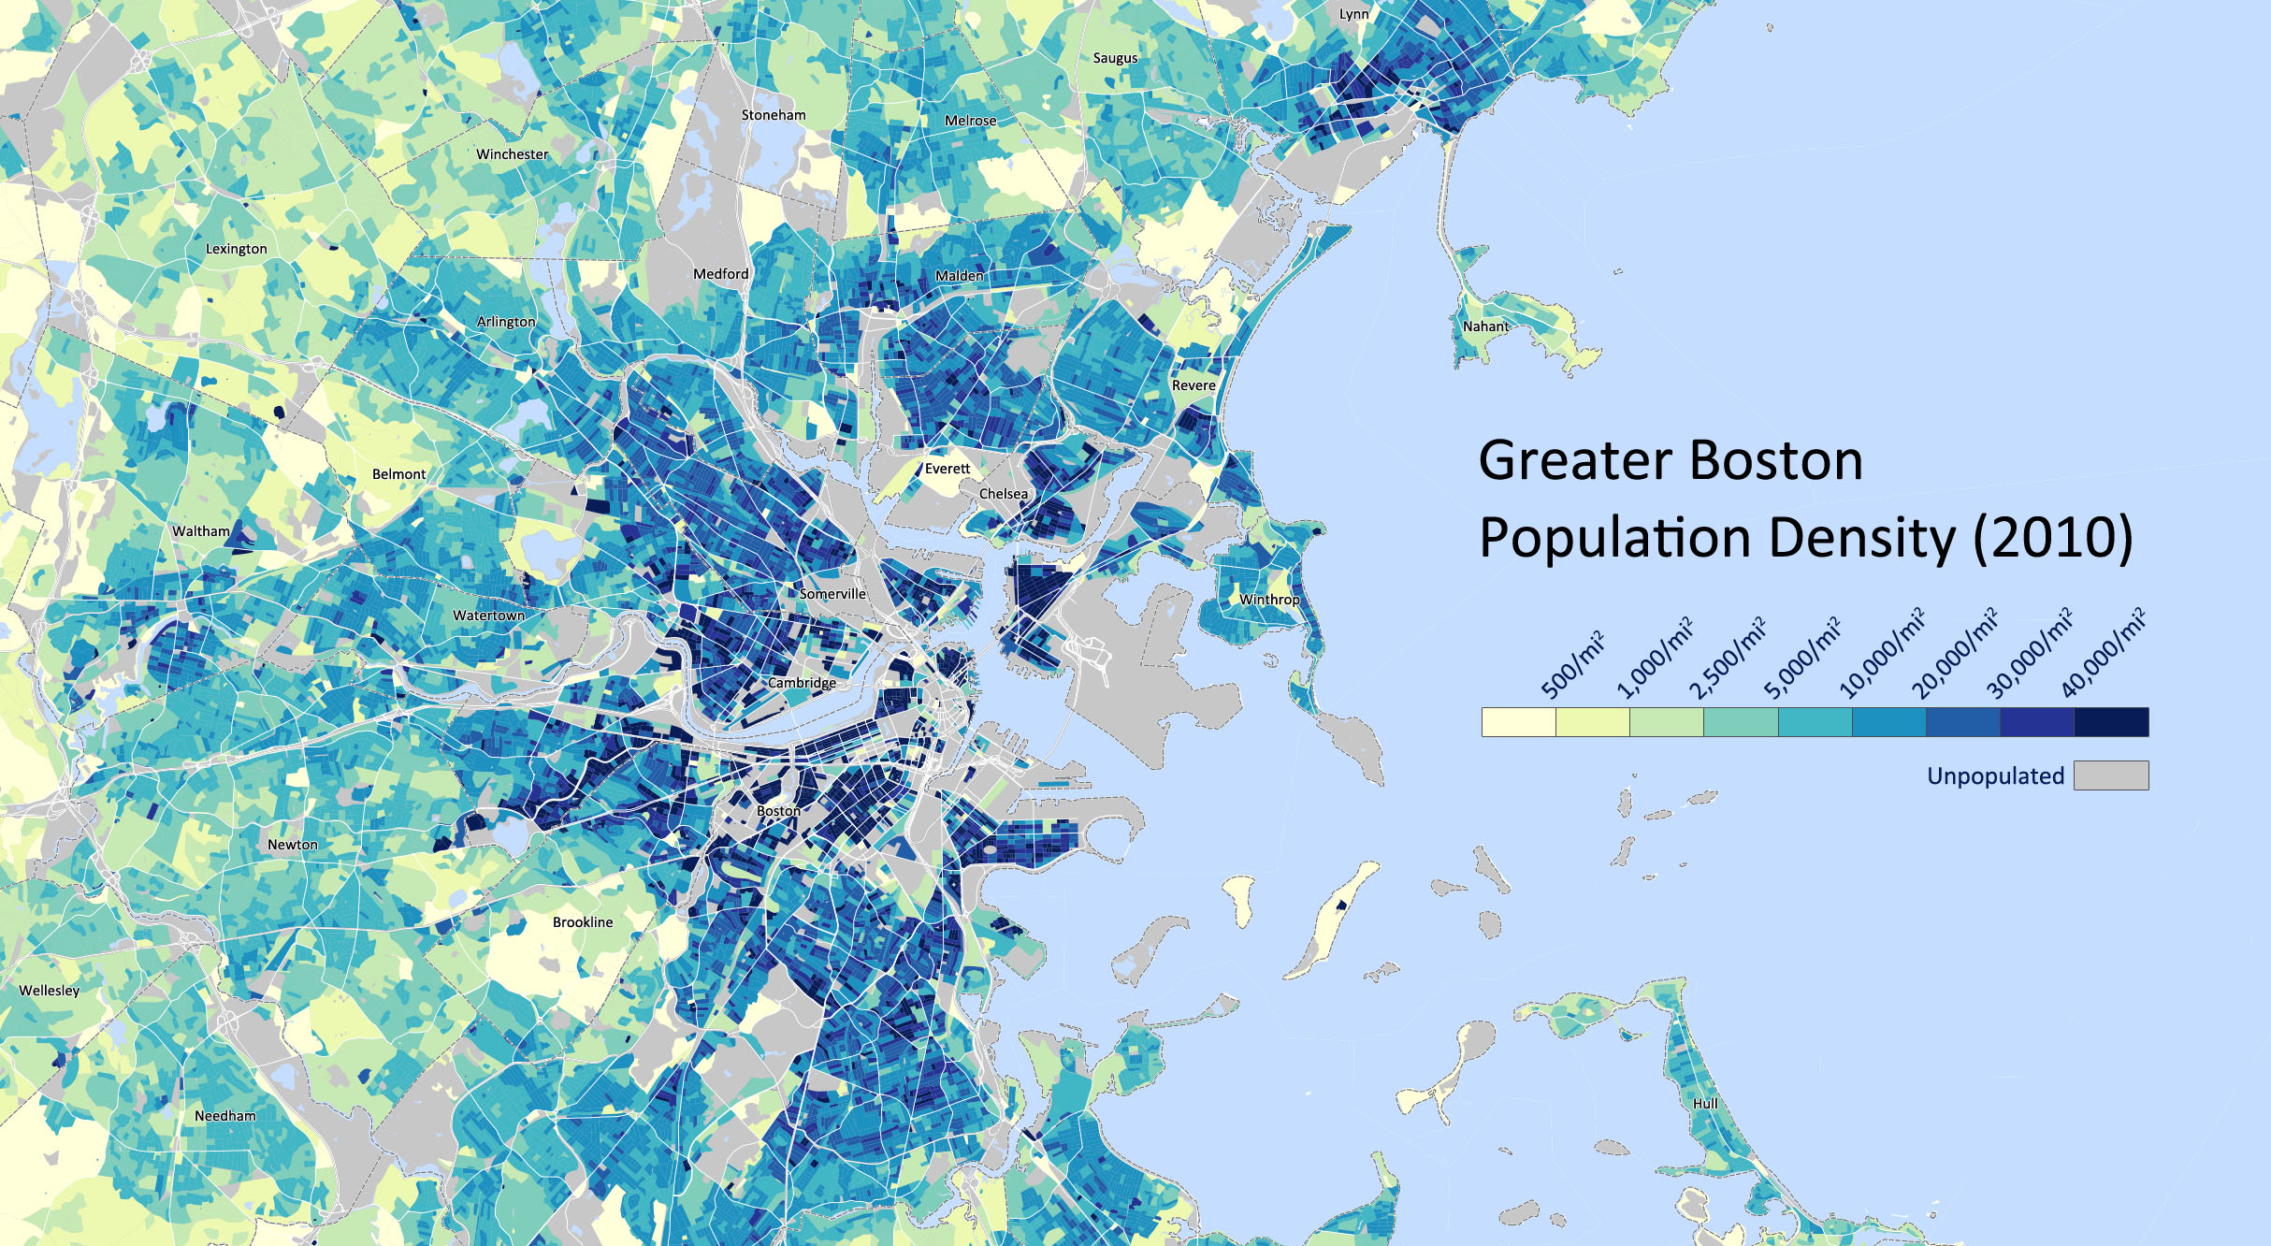
Choropleth Map
Bostonography.com

Slide 8
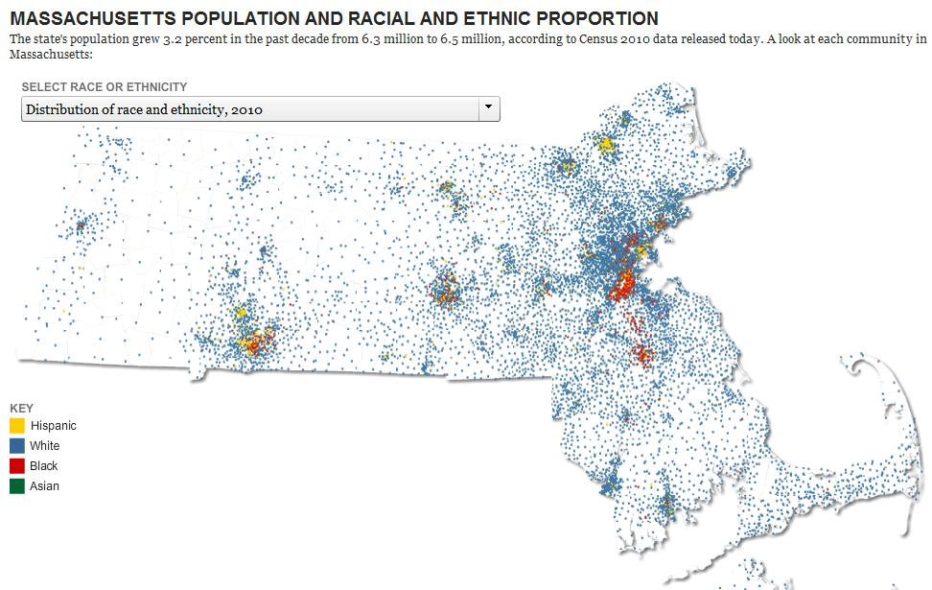
Dot Density Map
Boston.com

Slide 9
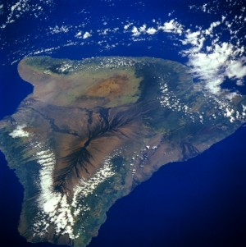
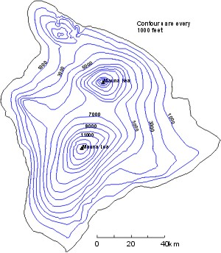
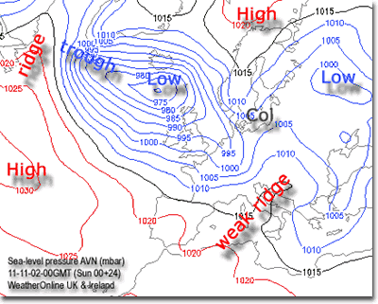
Isopleth/Contour Map
Looking down on the Big Island from the Space Shuttle.
A topographical map of Hawaii.

Slide 10
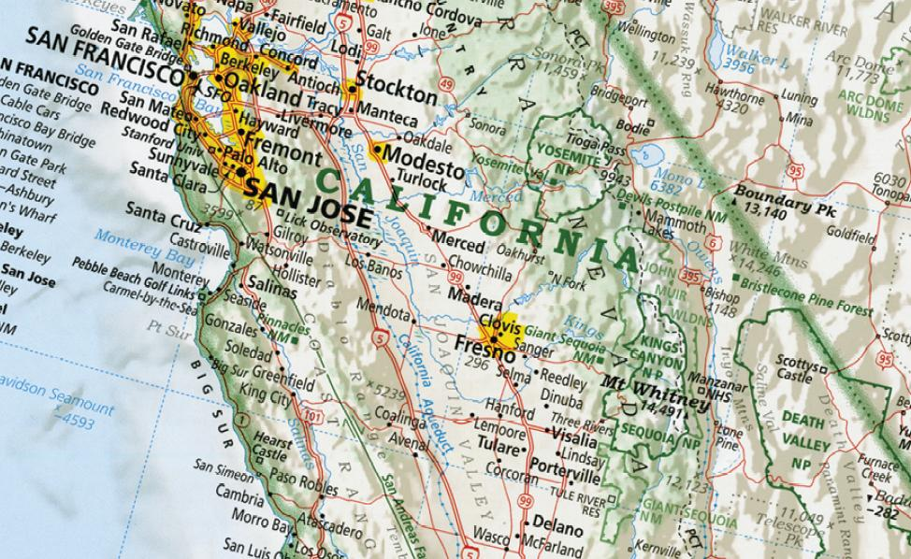
Displaying the Data
Have to consider scale of map
What are you trying to show
How much info is necessary?
Symbology is important
Maps can become cluttered and difficult to read - confusing

Slide 11
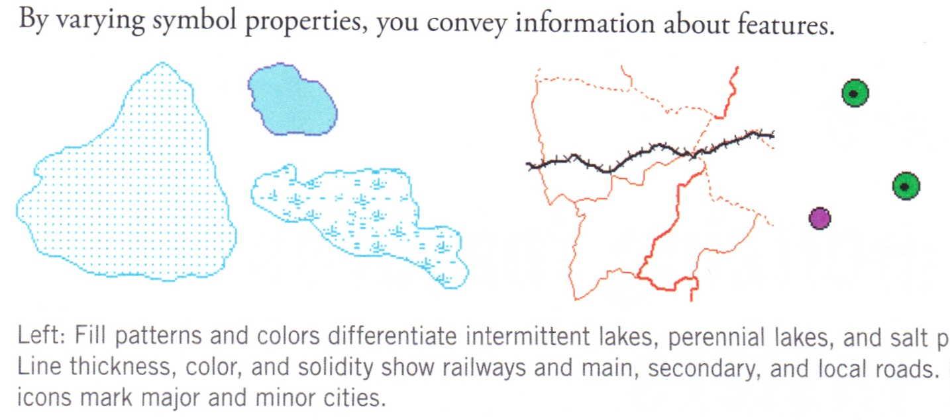
Symbology Basics
Symbols can indicate a type of feature and/or the importance of a feature
Can be based on nominal or numeric attributes
pans

Slide 12
Symbology Basics
Symbolizing points:
Color, size, shape, outline (filled vs. hollow)
Symbolizing lines:
Color, thickness, solid/dashed/dotted, shapes
Symbolizing polygons:
Fill color/pattern, outline color/pattern, opacity
Raster symbology:
color & transparency

Slide 13
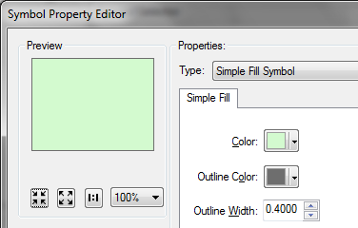
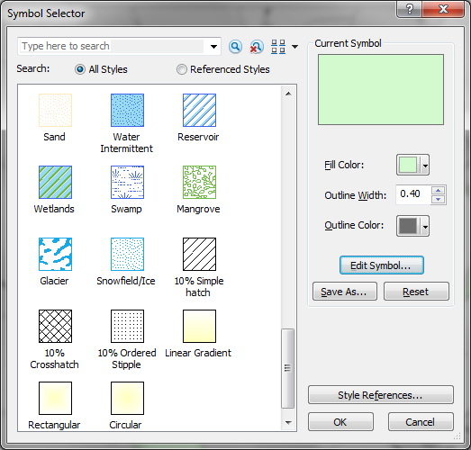
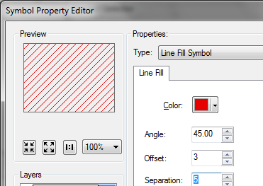
Polygon Symbology

Slide 14
Classifying Symbols
Values from the attribute table used to group features into categories or classes
Can be descriptive attributes (i.e. land use type)
Forest = green, water = blue, soil = brown
Numeric values grouped based on distribution
One value can be used to normalize another
i.e. Population normalized by Area = Pop. Density

Slide 15
Symbolizing Class Breaks
Graduated Colors
Color ramp (usually a single shade – choropleth)
Graduated Symbols
Set size range, modify the template
Proportional Symbols
Dot Density
Select Dot Size and Dot Value

Slide 16
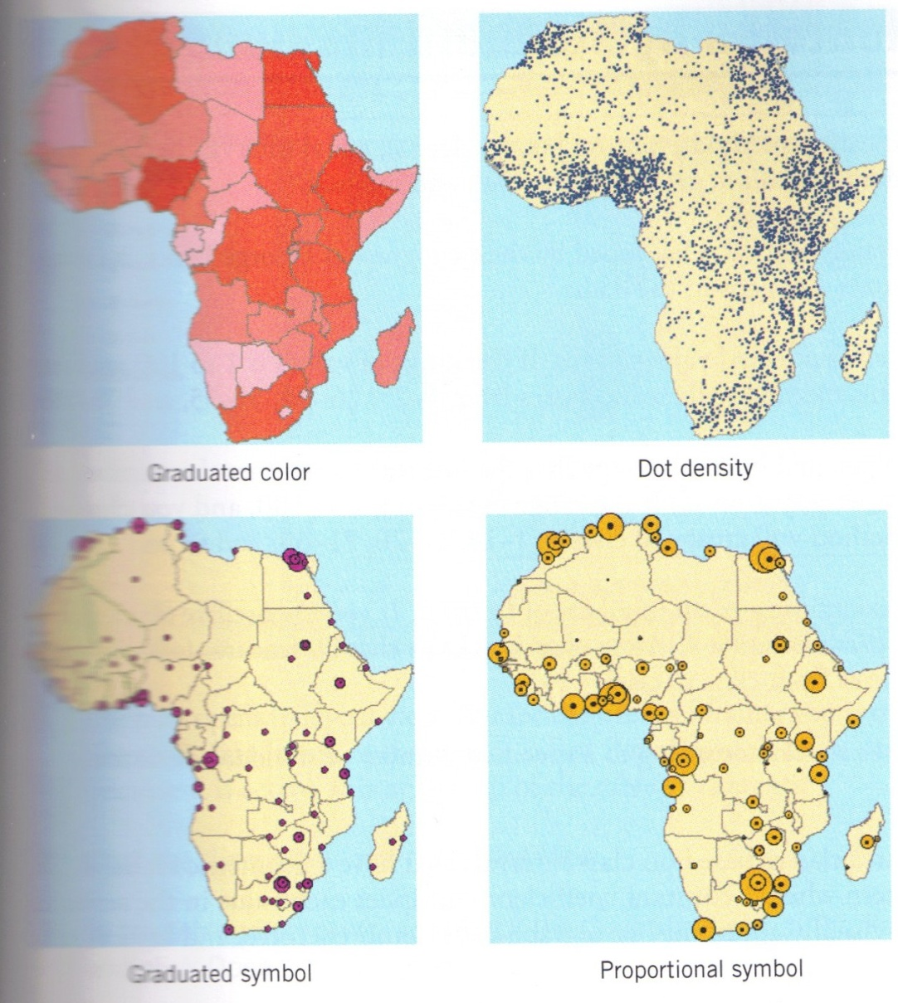
Africa Population
Four ways to depict the same data
Best choice depends on your data source and audience

Slide 17
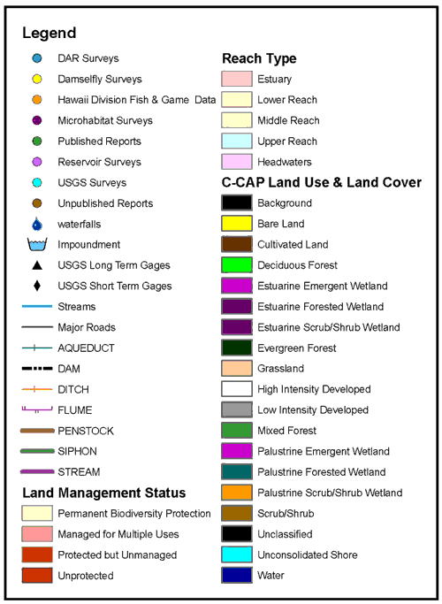
Legend
Legend crucial to interpreting the classes
All important layers should be included
Only layers that are “drawn” should be in legend
Layer names should be easy to interpret and no underlines, i.e. roads_arc
Play with the format to make it look good
Reorder legend items, most important on top

Slide 18
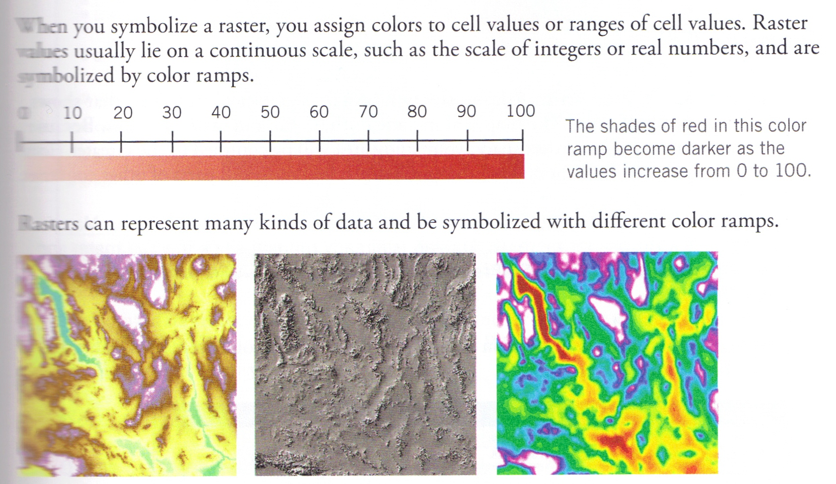
Raster Symbology

Slide 19
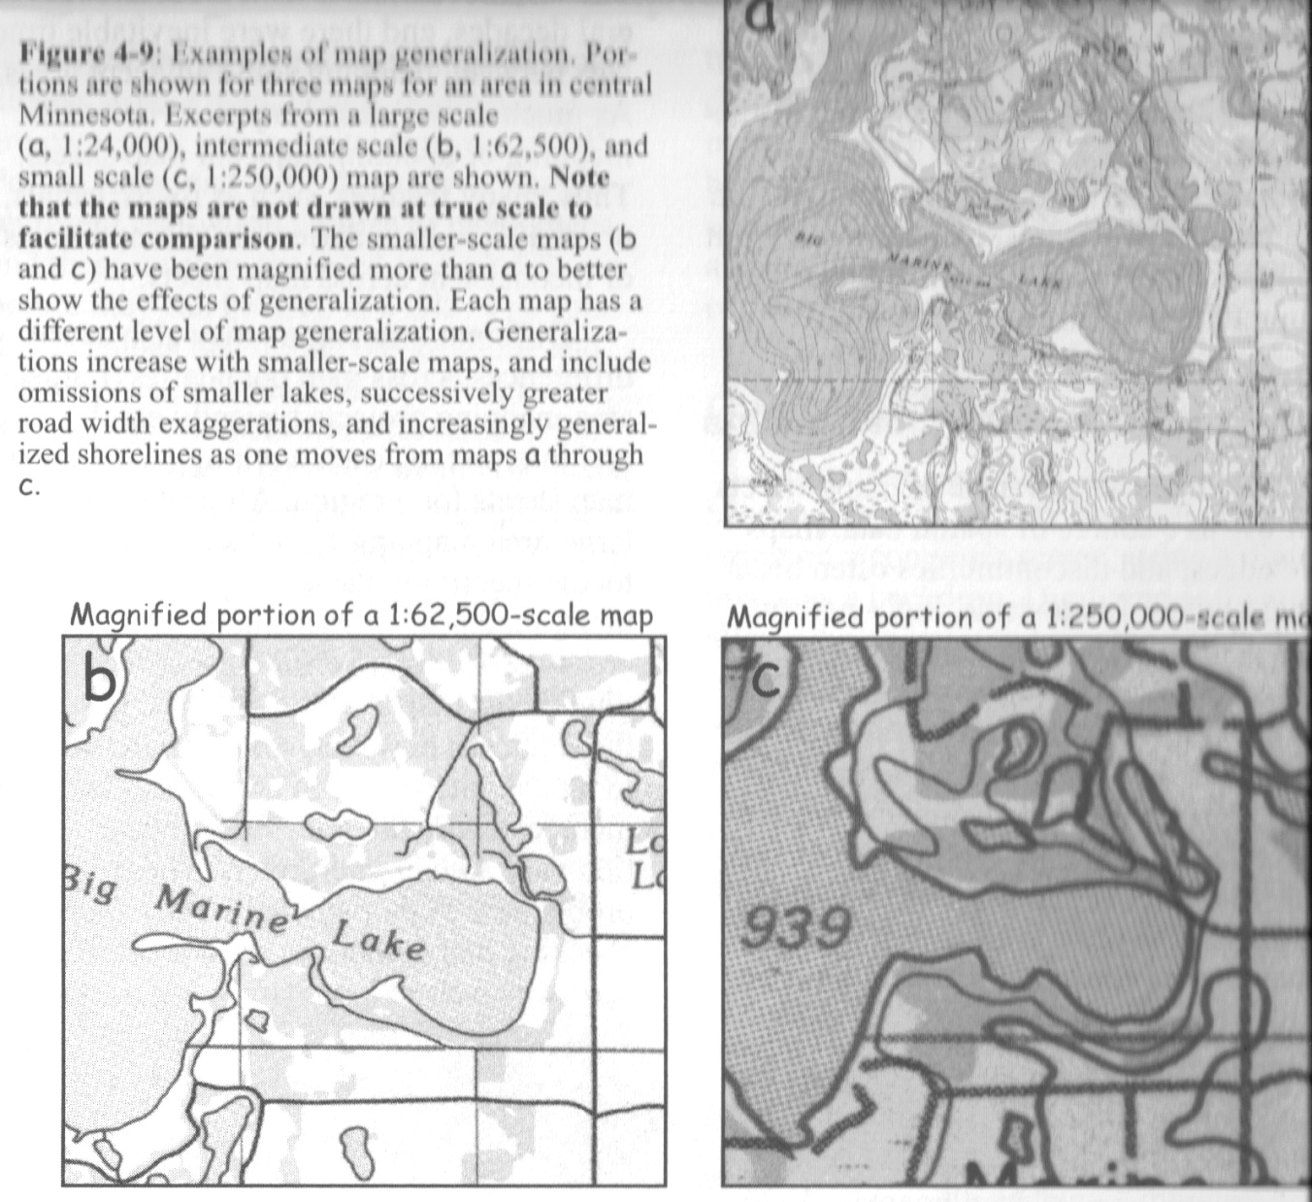

Symbols and Scale
Features may become more generalized
Point vs. Polygon

Slide 20
Cartography Basics
Consider the following:
Scale and extent of the map (and output medium)
Data you are using, and primary focus
Symbol shapes, sizes, and/or patterns
Labeling, including font and font size
Legend properties, size, and borders
Placement of all of the above elements
Using data frames
Important!
Who is map for
Color or black and white
Color blindness

Slide 21
Commuter Transit Mode

Slide 22
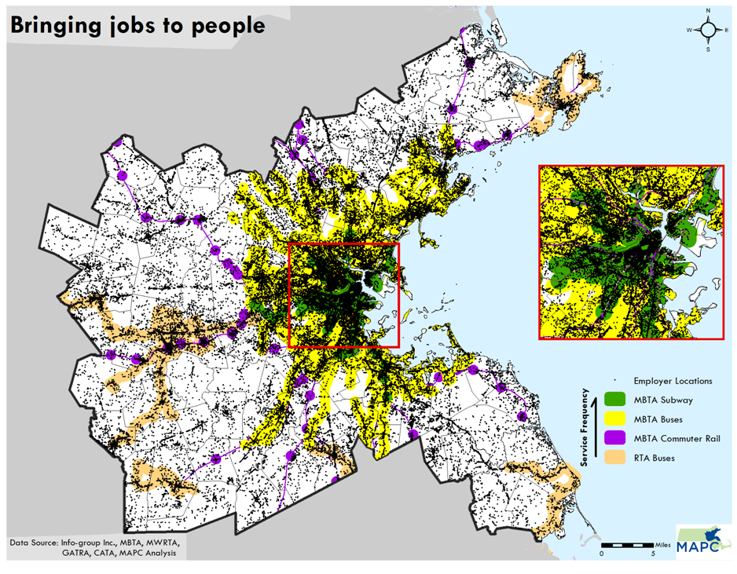

Slide 23
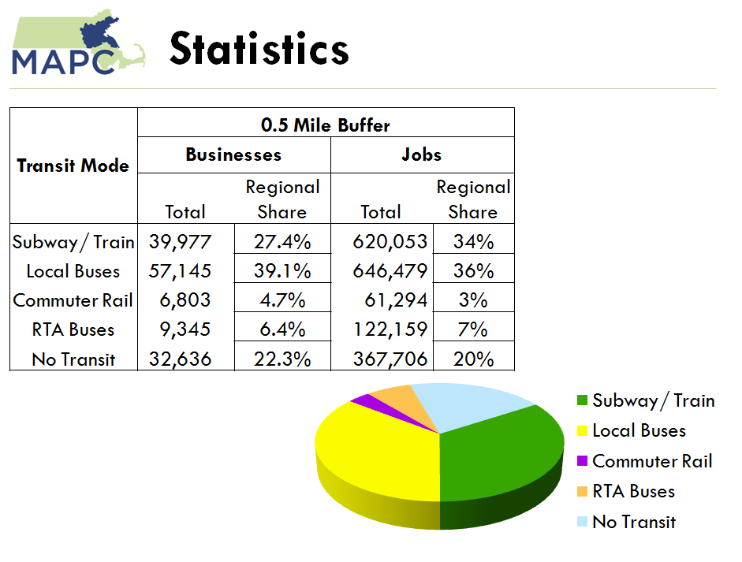

Slide 24
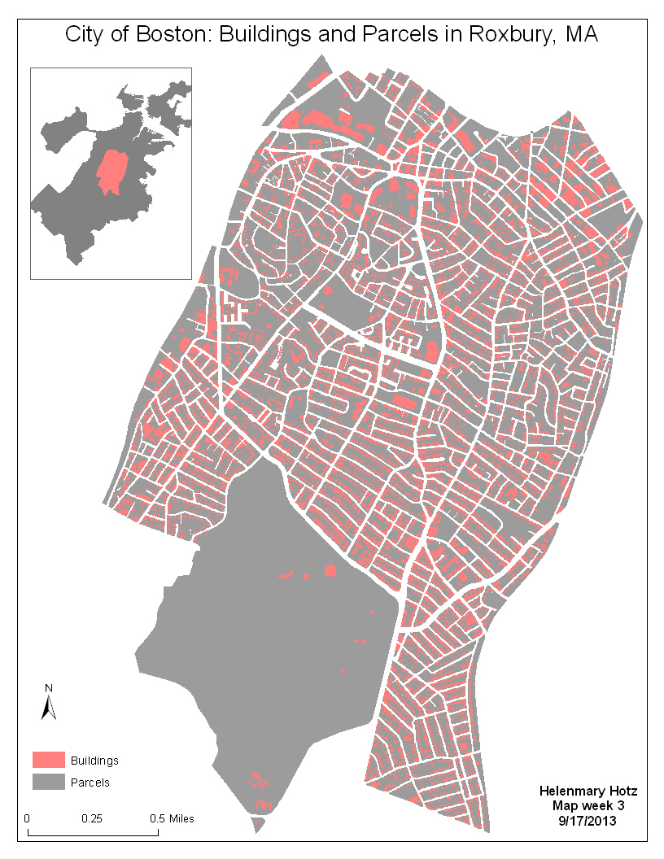
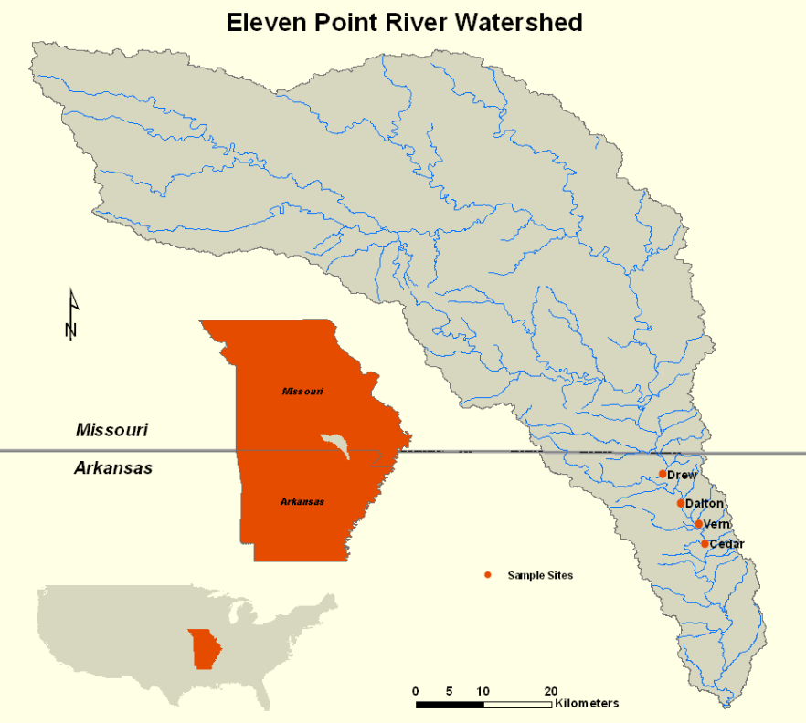
Use of Data Frames
To show relation of area to a larger region
To show geographic context

Slide 25
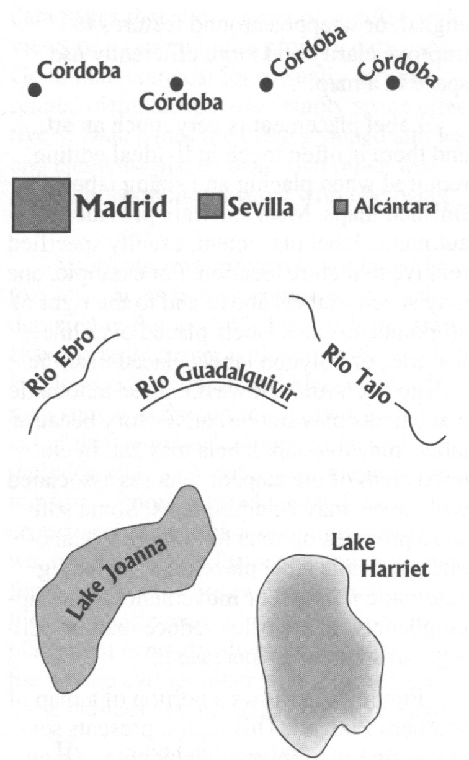
A few notes on labeling…
Labels are a crucial feature
Provide orientation
Call out important locations
Positioning labels is tricky
Choose a legible size
Avoid overlaps
Adjust angle, curvature
Try to stick to 1 or 2 fonts

