Slide 1
Lecture 2
Portraying Earth
Data types - File types

Slide 2
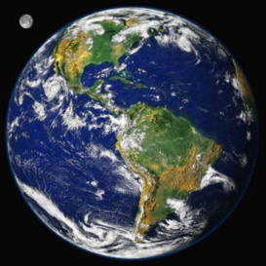
Size & Shape of Earth
Diameter = 8000 miles
Radius = 4000
Circumference = 25,000
Earth slightly flattened at poles - wider at equator
Earth tilted on axis at 23.5◦

Slide 3
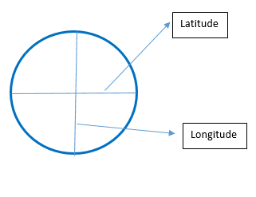
Latitude/Longitude
Latitude and Longitude define a unique location on the surface of the earth
Latitude is used to express distance north or south of the equator @ 0° to 90° N or S
Longitude shows east-west distance from the Greenwich meridian @ 0° to the International Date Line @ 180°
Locations are given in degrees, minutes, seconds or degrees and fractions of degrees
For example:
Boston, MA: Lat 42.37N – Long 71.03W
Boston, MA: Lat 42° 22’ 11” - Long 71° 1’ 47”

Slide 4
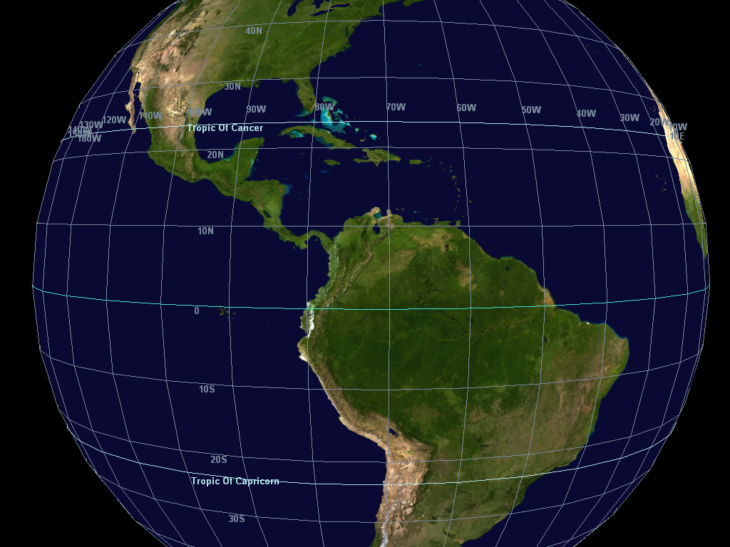

Slide 5
Map Projection
Map projection transforms the round surface (3D) of the Earth to display on a flat surface (2D), i.e. a map.
It is impossible to portray a curved (3D) surface on a flat (2D) map perfectly
There is always distortion
There is NO perfect projection
The main objective is to preserve either the shape or the area of the features - you can’t have it both ways!
Following slides show different projections:

Slide 6
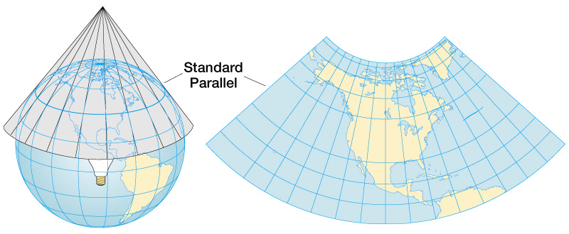
Conic Projection
Globe with light at center, projects images onto paper cone – when paper laid out flat, conic projection.

Slide 7
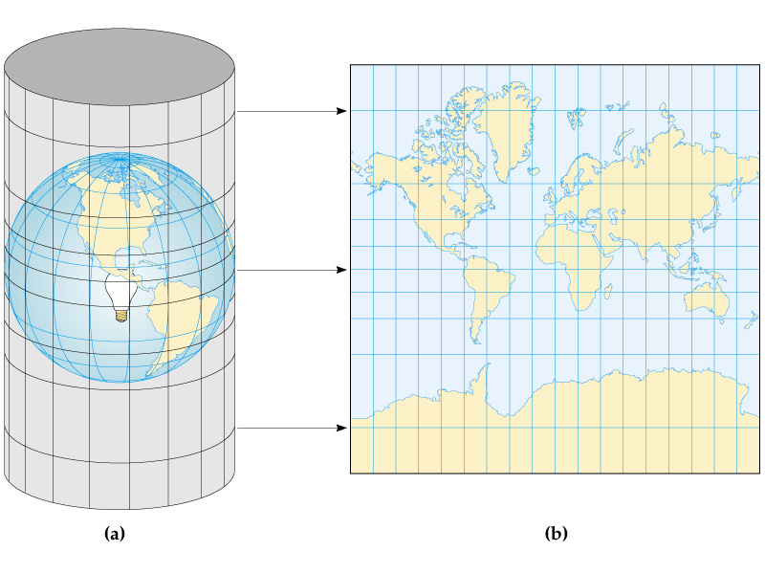
Cylindrical Projection
A globe with light in center projects onto paper cylinder – when paper laid flat, you have a cylindrical projection.

Slide 8
Mercator Projection
Mercator is the most well known projection
It is a special purpose map projection used for navigation
It is the only map projection that shows true compass bearings for navigation
It has area distortion at North and South latitudes
straight lines on a Mercator projection will always intersect longitude lines at the same angle 90◦- Mercator is the only map projection that does that

Slide 9
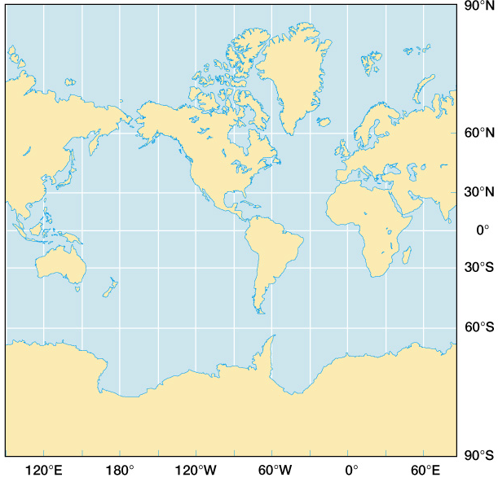
MERCATOR
PRO JECTION

Slide 10
South America = 17,819,000 sq km
Greenland = 2,166,086 sq km
Note the size of South America and Greenland
Conformal projection — preserves shapes

Slide 11

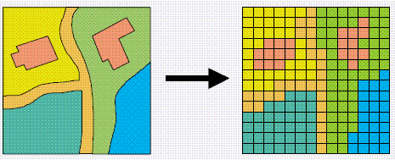
Data types
Two basic types of data:
Vector
Points
Lines
Polygons
Raster
Grid composed of cells i.e. an array pixels arranged in rows and columns each with its own value

Slide 12
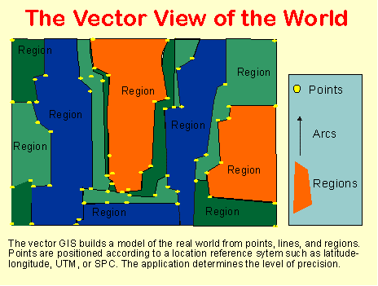
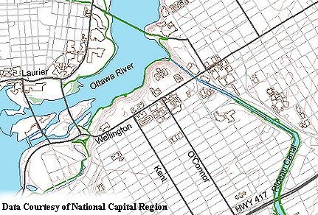
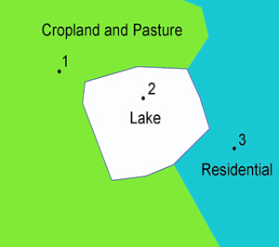
Vector data
A vector based system displays graphical data as points,
lines or curves, or areas with attributes.

Slide 13
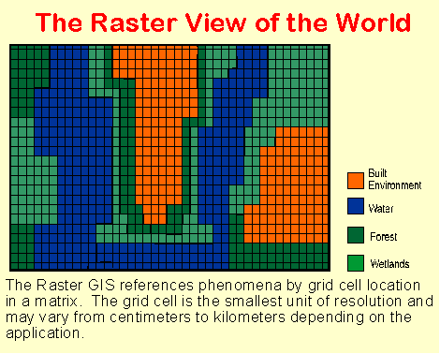
Raster data
A raster displays, locates, and stores graphical data by using a matrix or grid of cells.

Slide 14
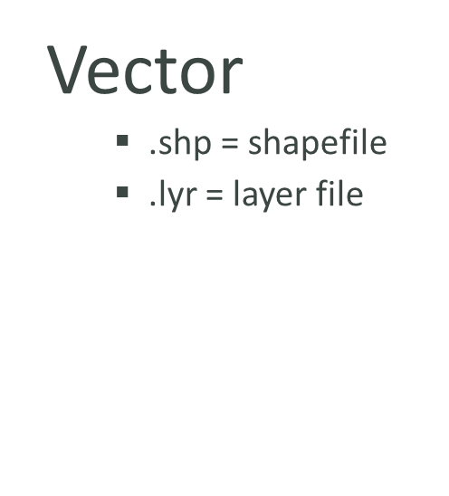
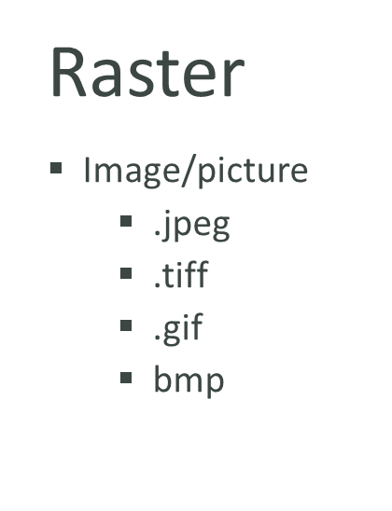
Portraying Earth File types & extensions
Globes vs. Maps – 3D vs. 2D
Shape – size
Lat/Long:
what is it
what units
Projections:
why do we need them
what do they do

