Slide 1
Lecture 1 Basics of GIS
Course overview & fundamentals

Slide 2
Course outline
Textbook: Getting to Know ArcGIS Pro 3.3
Selected readings
Lecture/ppt’s
Labs: Getting to Know ArcGIS Pro exercises & others
Thumb/hardrive for your work
Keep folder of exercise screenshots/maps or any hand in (email to me) assignments

Slide 3
Objectives
CONCEPT
Learn and understand concept of GIS… what a GIS is - what it can do
Know connection of data to a GIS
Know the analysis capabilities
Know the user’s part – that’s you
“BUTTONOLOGY”
Get up and running on ESRI software
Become familiar with the user interface and common commands

Slide 4
Software
ESRI – Environmental Systems Research Institute ArcGIS Pro 3.3
Operating System (OS): Microsoft Windows 11
Esri history
ESRI was founded as Environmental Systems Research Institute, Inc., in 1969. The headquarters of ESRI are in Redlands, California.
During the 1980s, ESRI devoted its resources to developing a core set of application tools that could be applied in a computer environment to create a geographic information system (GIS). This is what is known today as GIS technology.

Slide 5
History of GIS
GIS is generally said to have emerged in the 1980’s
Roger Tomlinson, a geographer, is said to be the “father of GIS.” He is the primary originator of modern computerized Geographic Information Systems.
During his tenure with the Canadian Federal Government in the 1960’s, he initiated, planned and directed the development of the Canada GIS, the first computerized GIS in the world.

Slide 6
Other GIS software
GIS: Autodesk - CAD – Intergraph – MapInfo – Maptitude
RS: ENVI – ERDAS – IDRISI
Open source software: Q GIS
Open source software (OSS) is computer software with its source code made available and licensed with an open source license in which the copyright holder provides the rights to study, change and distribute the software to anyone and for any purpose. Open source software is very often developed in a public, collaborative manner.
In other words, it’s FREE!

Slide 7
What is GIS?
Geographic Information System
What is a GIS?
A GIS is an information system that deals with geospatial/location data.
It allows you to store, retrieve, edit, delete, update and manipulate data. It also allows you to query and analyze data.
And, to graphically depict the data in layers for maps and other geographic display formats.

Slide 8
Geospatial Data
Information that identifies the geographic location and characteristics of natural or constructed features and boundaries on the earth
Any data with a geospatial reference. For example, census data by block or zip code or street address, place name or administrative area
Data and information that are referenced to a location on the Earth's surface through precise scientific coordinates such as maps, charts, air photos, satellite images, and land and water surveys

Slide 9
Metadata
Metadata is simply data about data
It describes the attributes and contents of an original document or work
Metadata consist of information that characterizes data
Metadata are used to provide documentation for data products. In essence, metadata answer who, what, when, where, why, and how about of the data documentation

Slide 10
GIT: Geospatial Information Technologies
GIS: Geographic Information System
GPS: Global Positioning System
GPR: Ground Penetrating Radar
RS: Remote Sensing
LIDAR: Light Detection and Ranging

Slide 11
GPS: Global Positioning System
A satellite based system that enables accurate positioning data – lat/long
Network of 24 high-altitude, earth orbital satellites
Location determined by triangulation (but really need min of 4)
4 of these are always in view from anywhere on Earth

Slide 12
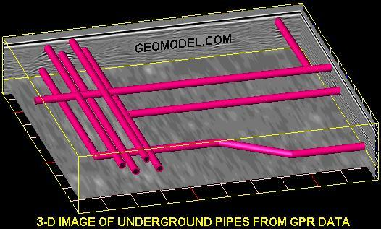
GPR
Ground penetrating radar (GPR) produces an underground cross-sectional, two-dimensional image of the soils and subsurface features. Three-dimensional GPR images, such as the one above, can be produced using raw field data and post-processing software.

Slide 13
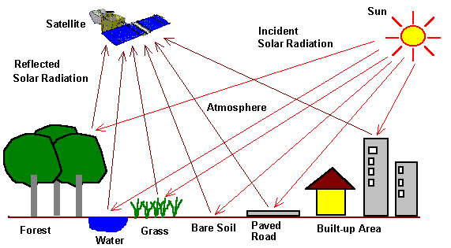
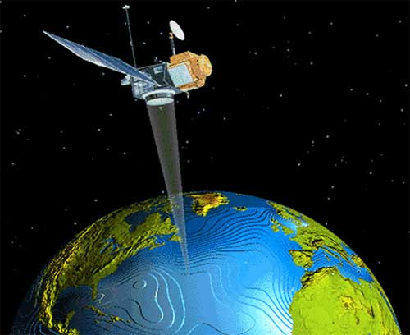
Remote sensing
Remote sensing is the process of gathering data about an object using tools that are not in direct contact with that object.
The science of capturing, identifying, classifying and evaluating objects, areas or phenomena using data recorded by sensing devices in aircraft or in satellites

Slide 14
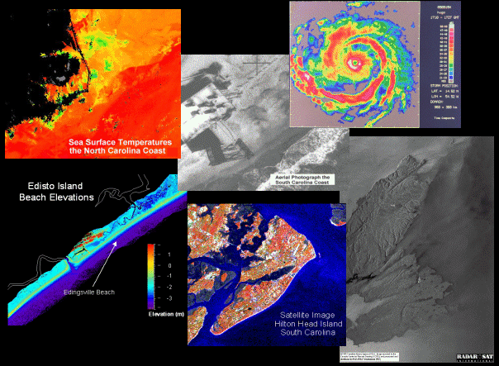

Slide 15
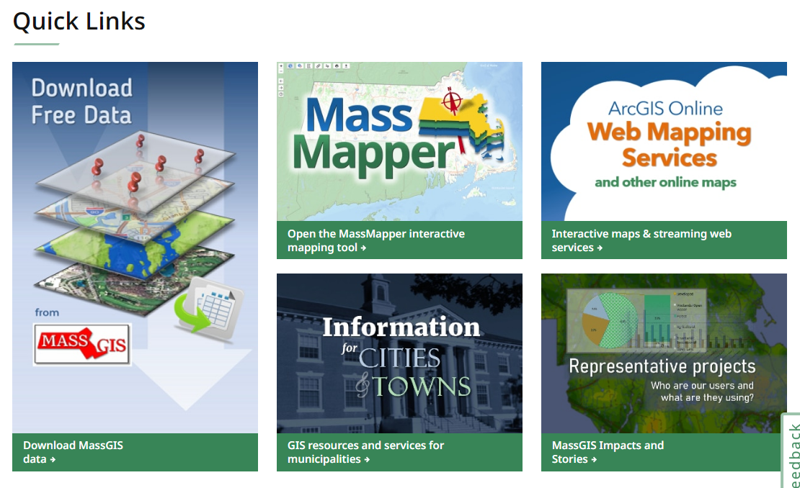
MassGIS
Office of Geographic and Environmental Information
Massachusetts geospatial data repository
https://www.mass.gov/orgs/massgis-bureau-of-geographic-information

Slide 16
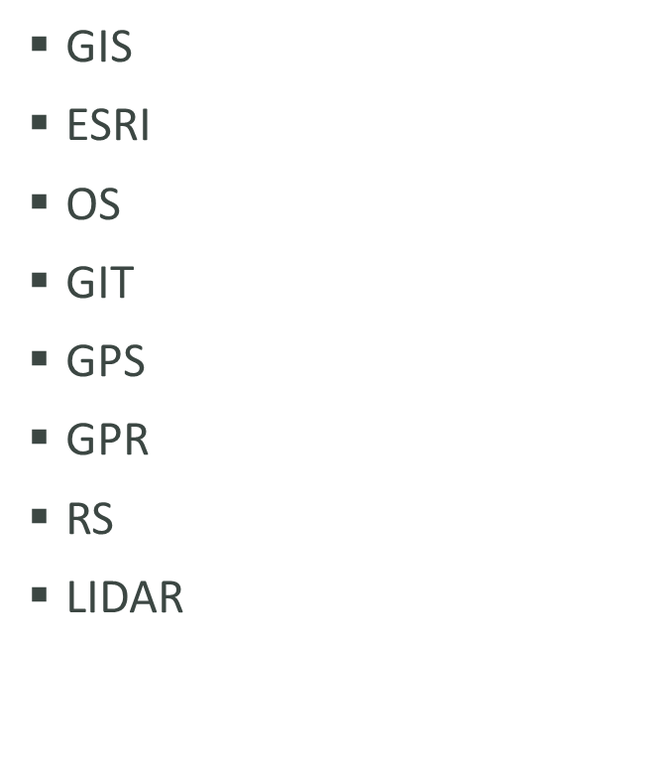
GeoInfo Acronyms
What is GIS?
What is a GIS?
What is geospatial data?
What is metadata?
Data types
File types
Maps & Projections
Applications
Spatial Analysis

